Slide 1
Metabolic Control and Regulation
Yoshi Goto: iGEM Drylab Simulation Stolen Borrowed from BIOEN 424 April 30th 2018

Slide 2
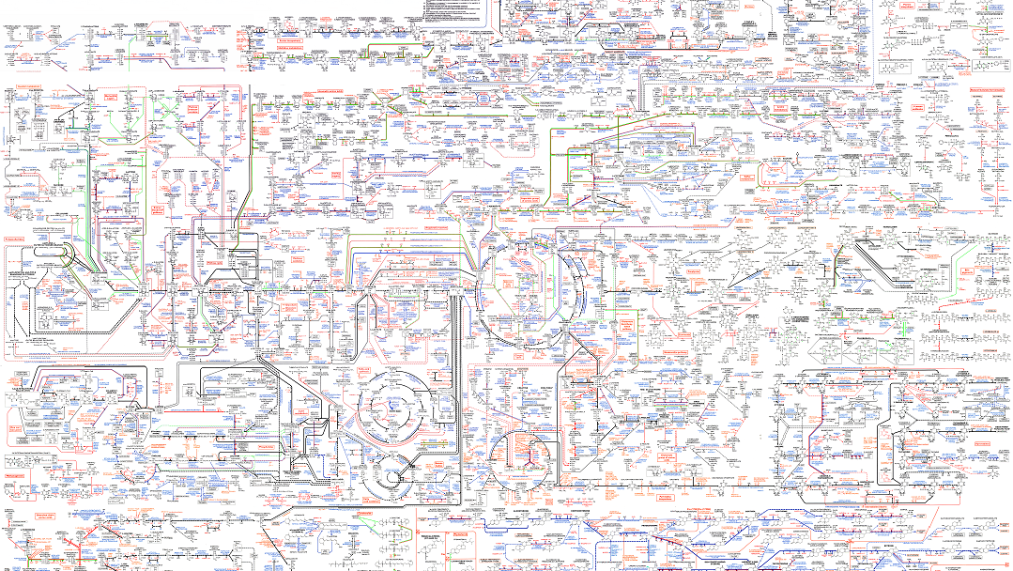

Slide 3
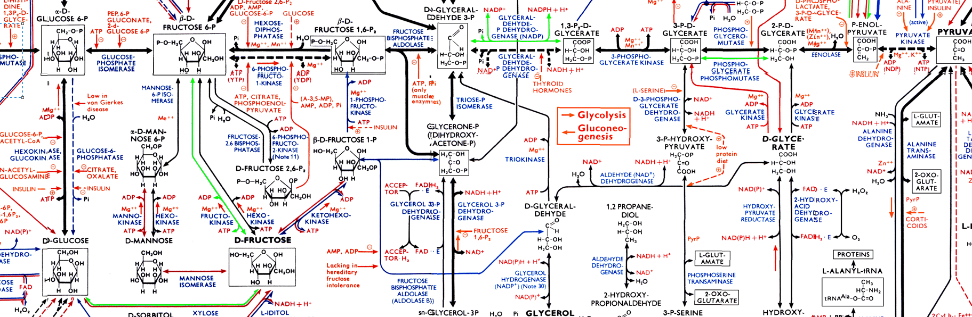

Slide 4
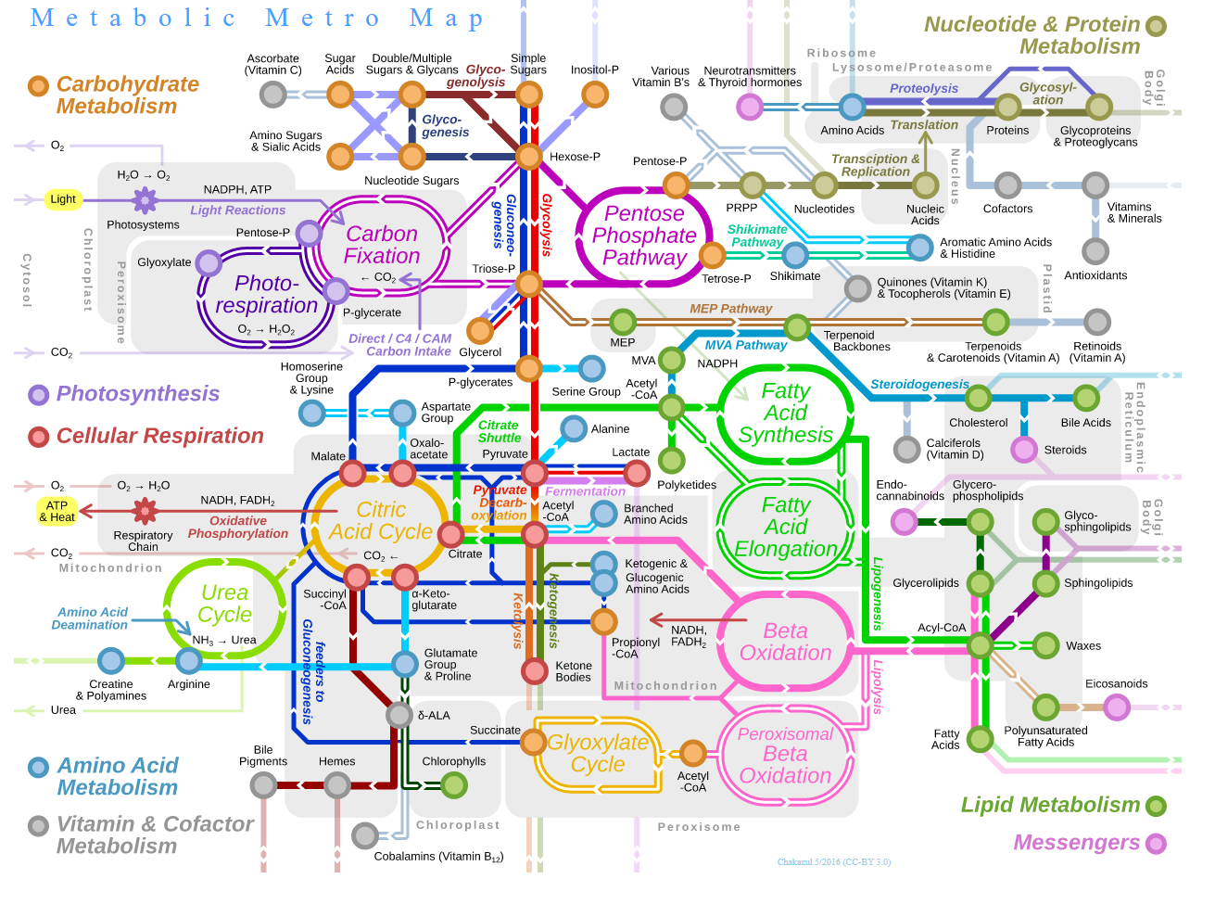

Slide 5
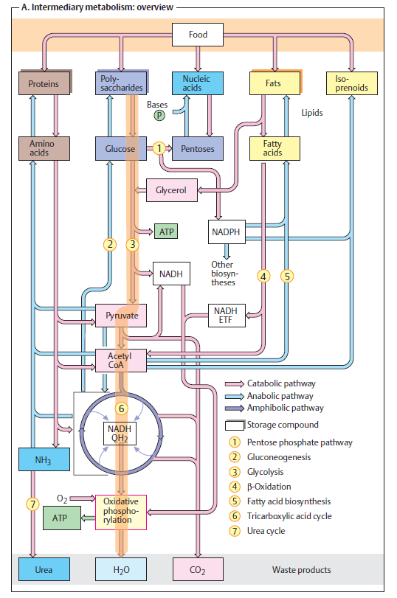

Slide 6
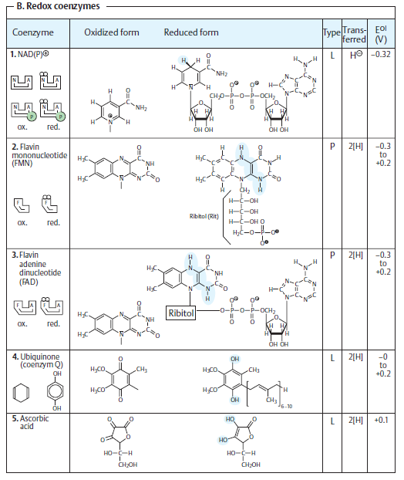
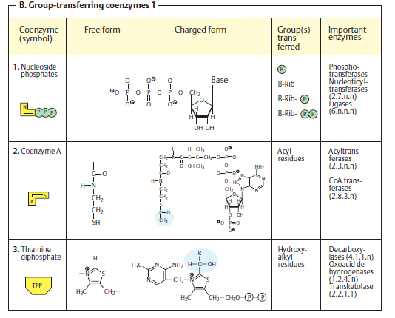

Slide 7
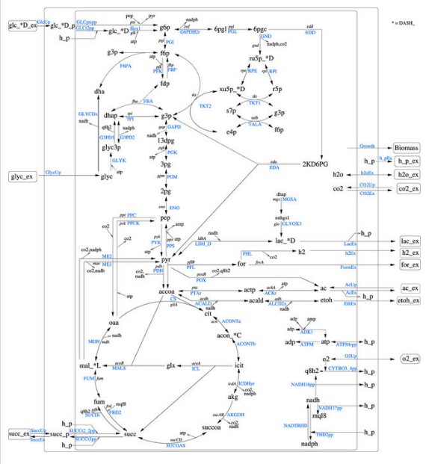
Reduced E. coli Map
The network comprises 486 metabolites and 499 reactions
Hädicke, Oliver, and Steffen Klamt. "EColiCore2: a reference network model of the central metabolism of Escherichia coli and relationships to its genome-scale parent model." Scientific Reports 7 (2017): 39647.

Slide 8
E. coli: Ecocyc
EcoCyc content and E. coli gene product functions (2017)
Proteins | 4316
tRNAs | 89
rRNAs | 22
Misc RNAs | 64
Type | Number
Number of Reactions | 2583
Number of metabolites | 1805
Example pathway:
https://ecocyc.org/ECOLI/NEW-IMAGE?type=PATHWAY&object=PWY-7219&detail-level=2
Keseler, Ingrid M., et al. "The EcoCyc database: reflecting new knowledge about Escherichia coli K-12." Nucleic acids research 45.D1 (2016): D543-D550.

Slide 9
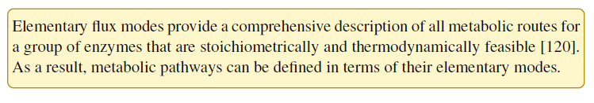
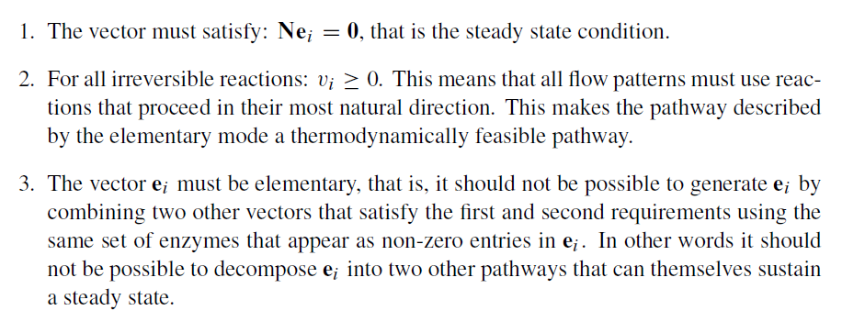
What is a pathway?

Slide 10
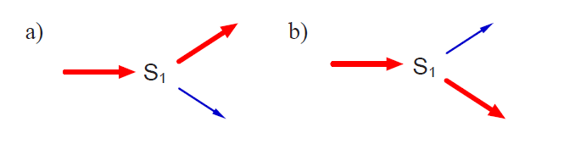
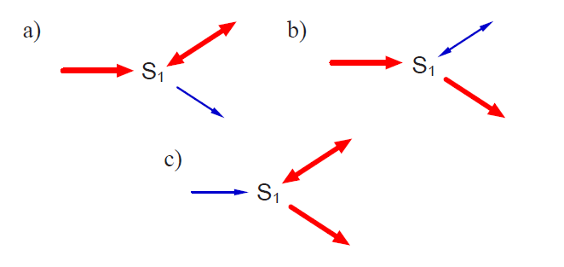
Elementary Modes

Slide 11
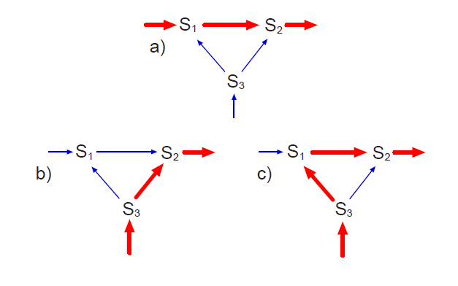
Elementary Modes

Slide 12
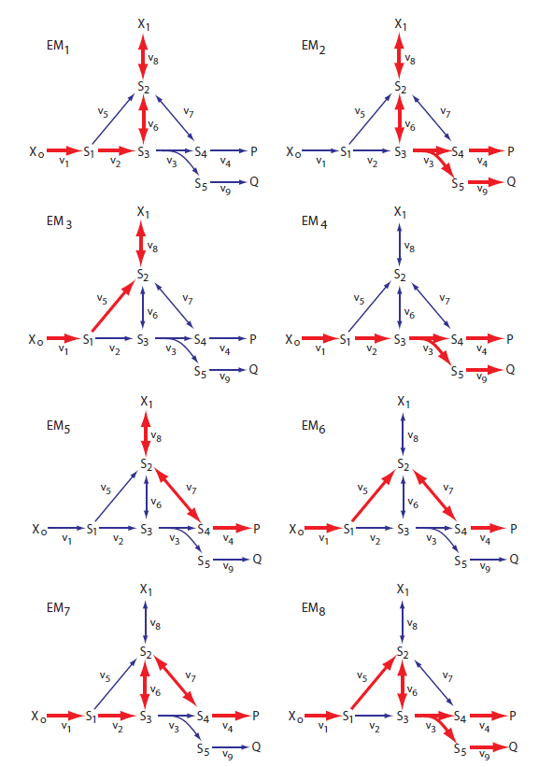
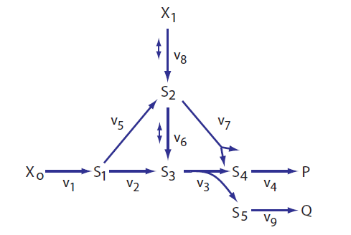
Elementary Modes
DEMO

Slide 13
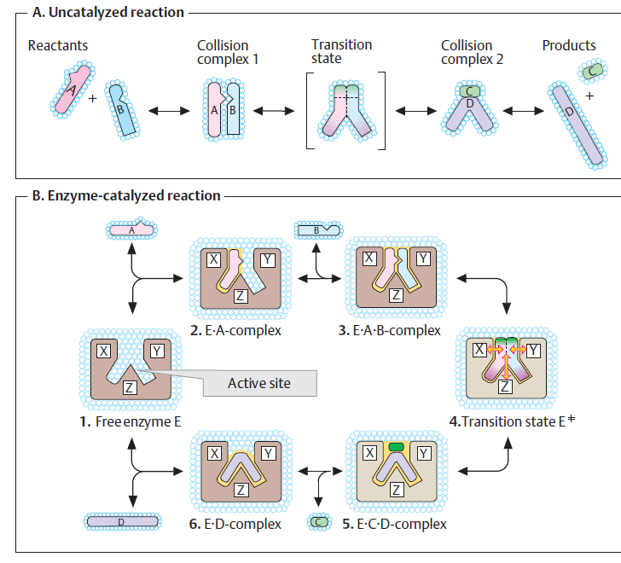
Enzyme Catalysis

Slide 14
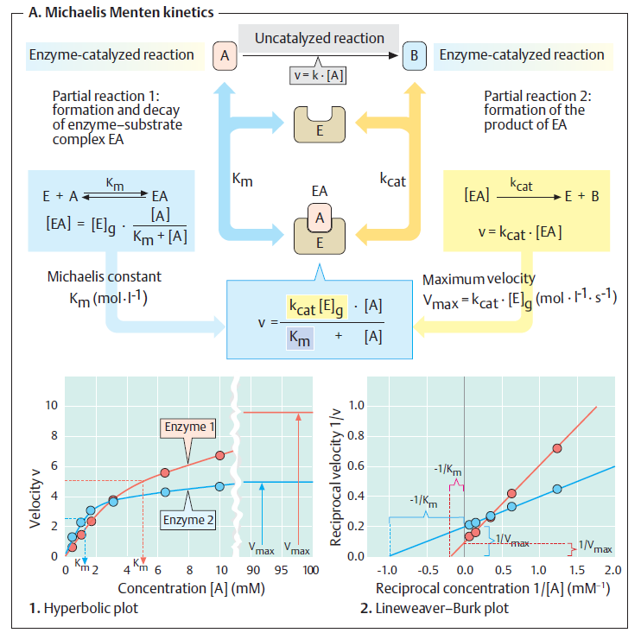







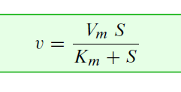
Enzyme Catalysis

Slide 15
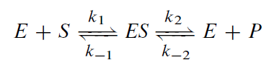
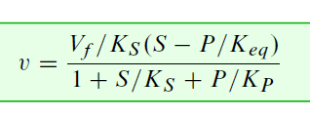
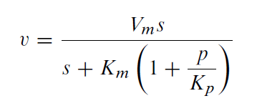

Reversible Enzyme Catalysis
Almost all enzymes are either reversible or product
inhibited to varying degrees.

Slide 16
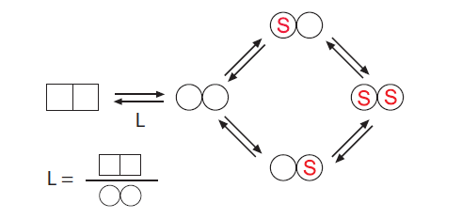
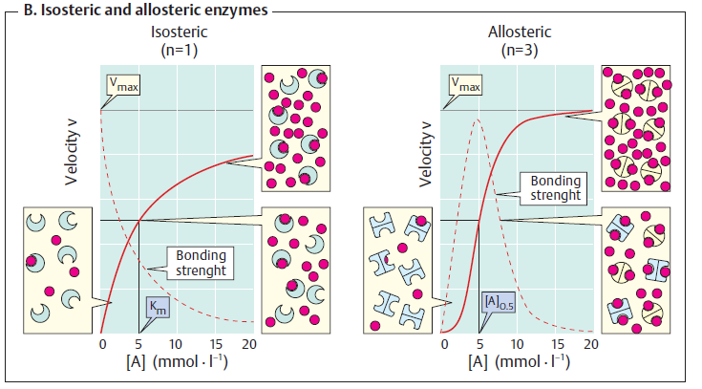
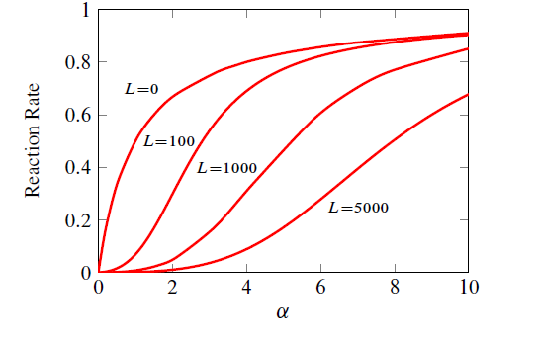
Cooperativity

Slide 17
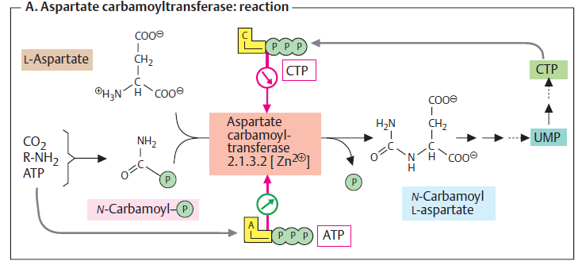
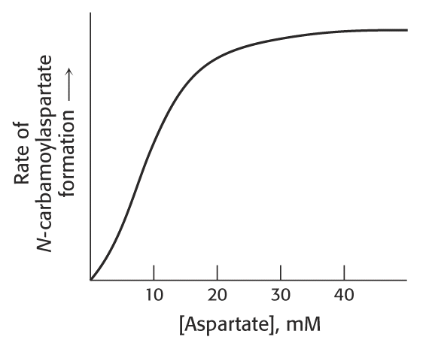
Aspartate carbamoyltransferase (ACTase)

Slide 18
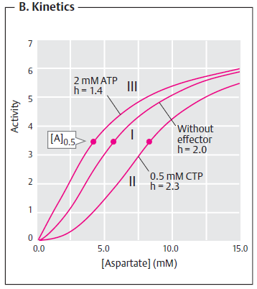
Aspartate carbamoyltransferase (ACTase) Biosynthesis of Pyrimidines

Slide 19
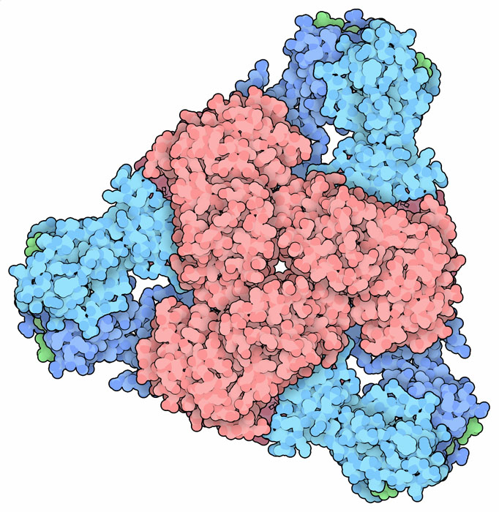
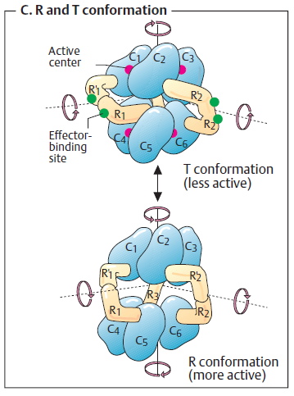
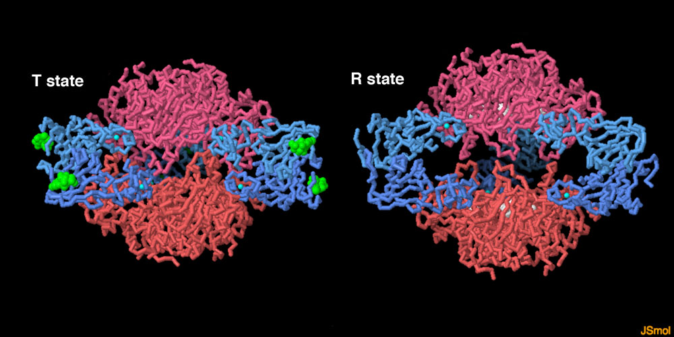
Aspartate carbamoyltransferase (ACTase)
CTP
Less Active
More Active
ATP and Aspartate
Red: Catalytic Subunits x 6
Blue: Regulatory units x 6
Green: CTP

Slide 20
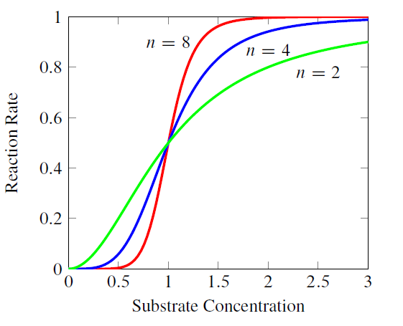
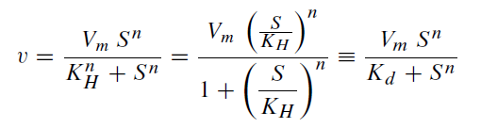

Rate Laws for Simple Cooperativity

Slide 21
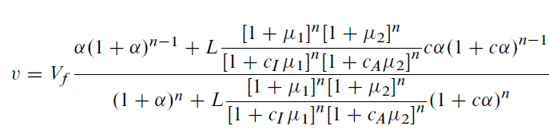
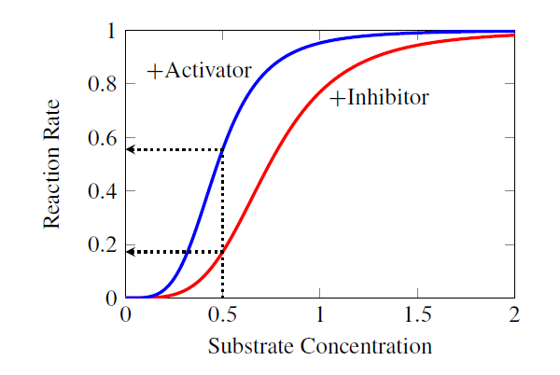
Allosteric Control: Things get complicated

Slide 22
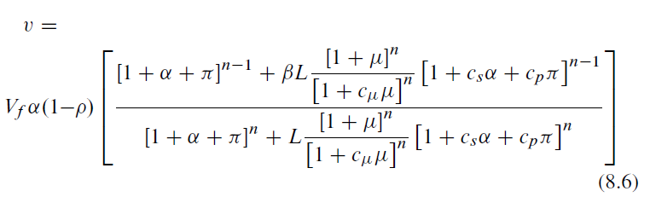
Reversible Allosteric Control

Slide 23
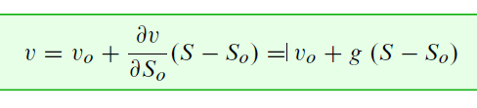
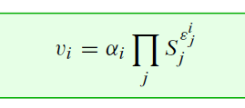
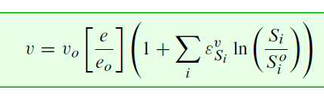
Approximations
Linear
Power Law
Lin-Log

Slide 24
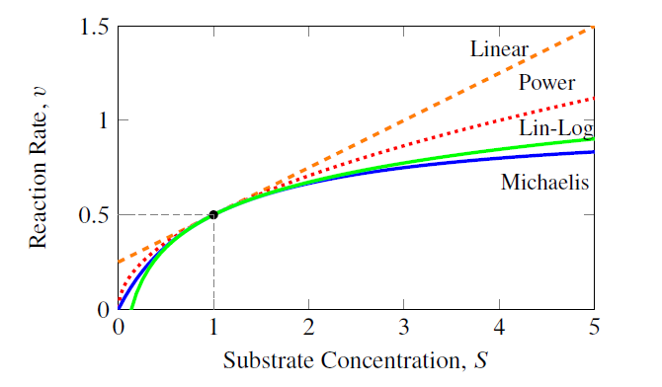
Approximations

